Slide 1
Court
of
Honor

Slide 2
Agenda
Opening Flag
Introduction
Announcements
SPL
Program
Committee
Awards
Service Stars
Den Chief
Merit Badges
Rank Advancement
Scoutmaster Minute
Prayer
Closing Flag

Slide 3
Opening Flag

Slide 4
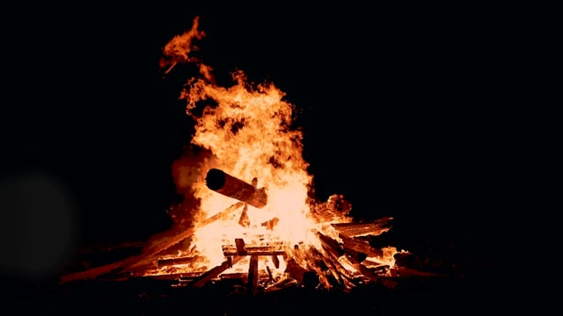
Broden Muller
Master of Ceremonies
August - 2020

Slide 5
Anouncements
Tucker Anderson – Senior Patrol Leader
Tom Boyd – Scoutmaster
Lou Zangara – Committee Chair

Slide 6
Awards
Service Stars
Den Chief
Merit Badges
Rank Advancement

Slide 7
Service Stars
1 Year
Cameron Arn
Carson Harrop
Broden Muller
Dylan Schweitzer
Zack Steele
Dominick Weckerly
2 Years
Topher O’Conner
5 Years
Gabe Boyd
Dominick Zangara
6 Years
Ian Kleditz
Austin March
Zach Szklarz

Slide 8
Den Chief
Dylan Schweitzer

Slide 9
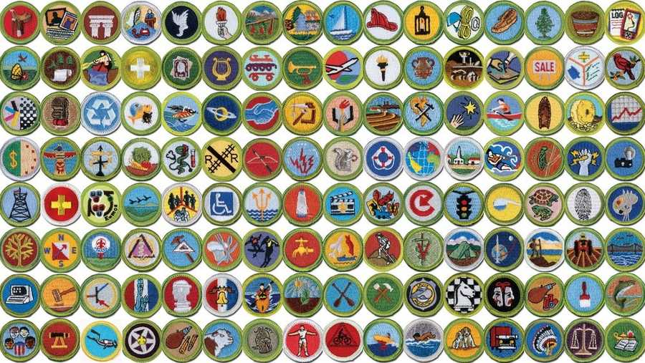
Merit Badges

Slide 10
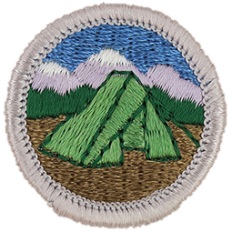
Gabe Boyd
Camping

Slide 11
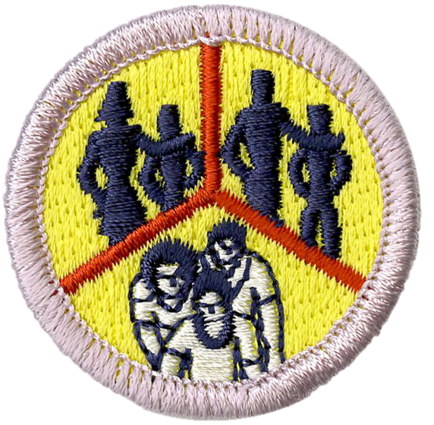
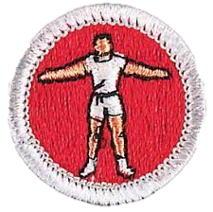
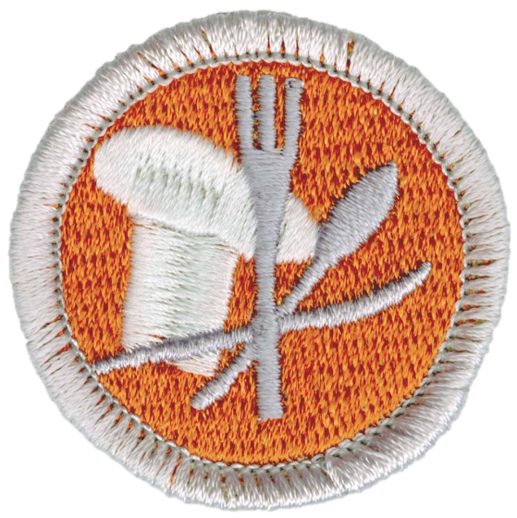
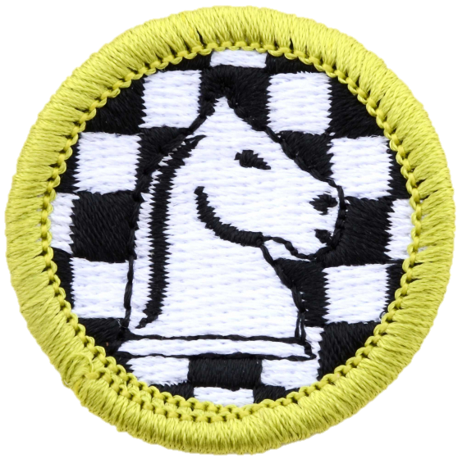
Ian Kleditz
Family Life
Personal Fitness
Cooking
Personal Fitness
Chess

Slide 12
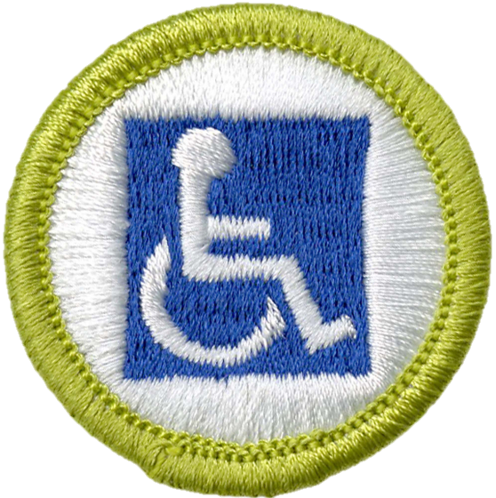
Austin March
Scouting Heritage
Programming
Disabilities Awareness

Slide 13
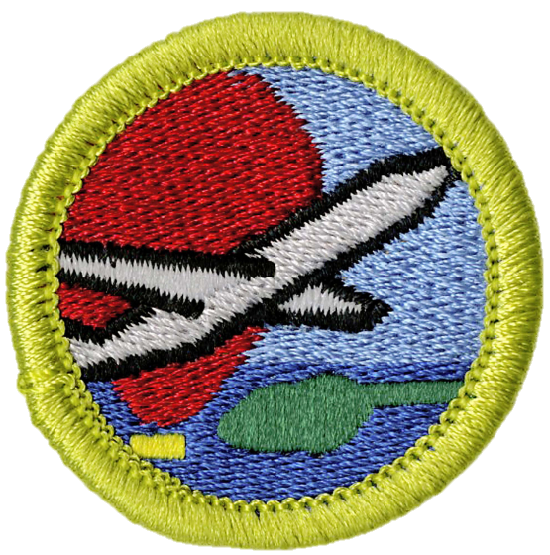
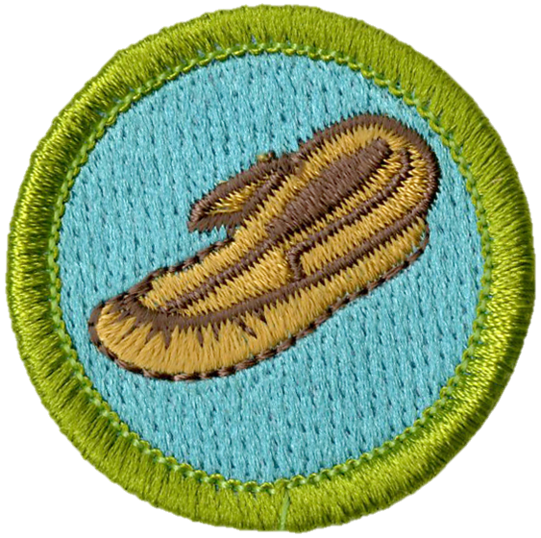
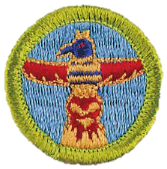
Dylan Schweitzer
Aviation
Leatherwork
Wood Carving

Slide 14
Zack Steele
Aviation

Slide 15
Zach Szklarz
Family Life

Slide 16
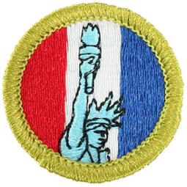
Dominick Zangara
American Heritage
Search and Rescue

Slide 17
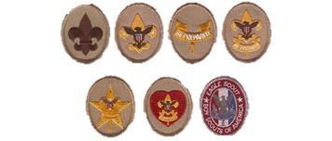
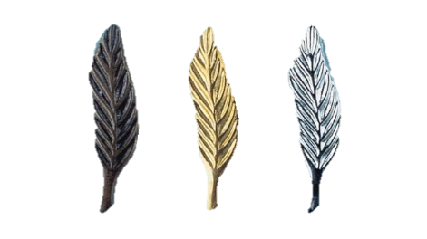
Rank Advancement

Slide 18
Scout Rank
Throughout the year we have the pleasure of welcoming new Scouts to our Troop. When each new boy joins the troop, he is encouraged to quickly earn the Scout Rank. To do this, a boy must learn the Boy Scout Oath, Promise and Law as well as the Scout Sign, Salute, and Handshake.

Slide 19
Scout Rank
We recognize the following Scouts this evening for earning the Scout Rank since our last Court of Honor:
Ethan Carpenter
Landon Hays
Dylan Schweitzer

Slide 20
Tenderfoot Rank
Tenderfoot requirements offer a taste of the great adventures awaiting you in Scouting and can give you the basic skills you'll need to begin taking part in those adventures. You met many challenges in earning the Tenderfoot badge and are to be congratulated.

Slide 21
Tenderfoot Rank
We recognize the following Scouts this evening for earning the Tenderfoot Scout Rank since our last Court of Honor:
None this evening

Slide 22
Second Class Scout
To earn Second Class, a Scout must learn how to use a map and compass, how and when to build a campfire, and to safely use pocket knives and wood tools. Second Class Scouts have proven their abilities in camping, first aid, and swimming, and other Scout skills.

Slide 23
Second Class Scout
We recognize the following Scouts this evening for earning the Second Class Scout Rank since our last Court of Honor:
Zack Steele
Dominick Weckerly
Jack Fairman
Carson Harrop

Slide 24
First Class Scout
The founder of Scouting, Lord Baden Powell, said that all Scouts should earn First Class. Now you have tested yourself even more. You have tried greater adventures and practiced your Scout skills many times. With your confidence and knowledge you now have, people will expect more of you, and you will expect more of yourself. You are prepared to be more of a leader in your patrol, your troop, and your community.

Slide 25
First Class Scout
We recognize the following Scouts this evening for earning the First Class Scout Rank since our last Court of Honor:
Carson Harrop

Slide 26
Star Scout
As you earn your Star Rank, you have more freedom to choose the directions that interest you. The focus shifts from basic Scout skills to earning the first six merit badges you will need for Eagle. Requirements now include service to others. The Star Rank also requires the Scout to be active in his troop for at least four months. Of course, you may take longer if you wish.
In addition, the Star Scout must serve his troop in a position of leadership for at least four months and take part in at least one service project.

Slide 27
Star Scout
We recognize the following Scouts this evening for earning the Star Scout Rank since our last Court of Honor:
None this evening

Slide 28
Life Scout
The Life Rank is one of the rarest ranks. This is the last rank before Eagle. You could complete your Eagle Rank now in as few as 6 months. We congratulate you and encourage you to reach for that next step. You have earned more than half of the merit badges required for Eagle.
The Life Rank also requires the Scout to be active in his troop for at least six months, serve his troop in a position of leadership for at least six months, and take part in at least one service project.

Slide 29
Life Scout
We recognize the following Scouts this evening for earning the Life Scout Rank since our last Court of Honor:
None this evening

Slide 30
Eagle Scout
The Eagle Rank is Scouting's highest award. Only a small percentage of Scouts have ever reached this lofty goal. The Eagle Rank is presented in a special Eagle Scout Court of Honor and not here this evening.

Slide 31
Eagle Scout
We recognize the following Scouts this evening for earning the Scout Rank since our last Court of Honor:
None this evening

Slide 32
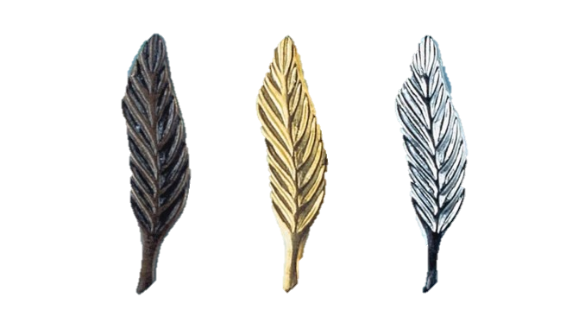
Eagle Palms
Some people think that after becoming an Eagle Scout, a scout has reached the end of the trail. That is not true. Scouts that continue to lead, serve, and grow as an Eagle, expanding scouting knowledge and sharing expertise with new scouts joining the troop may earn Eagle Palms. An Eagle Palm may be earned after 90 days of service to the troop, completion of 5 additional merit badges and a Scoutmaster Conference.
Silver + 15 Merit Badges
Bronze + 10 Merit Badges
Gold + 5 Merit Badges

Slide 33
Eagle Palms
We recognize the following Scouts this evening for earning an Eagle Palm since our last Court of Honor:
Austin March – 2nd Bronze Palm
+5 +10 +15 +20 Merit Badges

Slide 34
Scoutmaster Minute

Slide 35
Prayer

Slide 36
Closing Flag

Slide 37
Thanks
For
Coming

