Slide 1
Court
of
Honor

Slide 2
Agenda
Opening Flag
Introduction
Announcements
SPL
Program
Committee
Awards
Service Stars
50 Miler Award
Order of the Arrow
Merit Badges
Rank Advancement
Change of Leadership
Scoutmaster Minute
Prayer
Closing Flag
PLC

Slide 3
Opening Flag

Slide 5
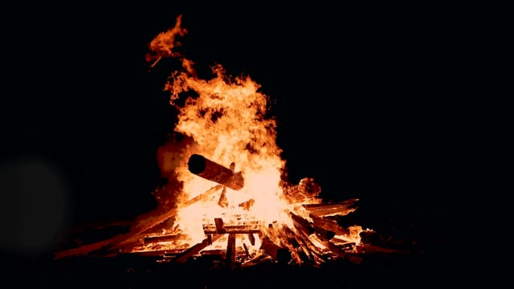
Jack Fairman Carson Harrop Mathew Mehta
Masters of Ceremonies
January - 2021

Slide 6
Anouncements
Jack Fairman – Senior Patrol Leader
Tom Boyd – Scoutmaster
Lou Zangara – Committee Chair

Slide 7
Awards and Recognition
Service Stars
50 Miler Award
Order of the Arrow
Merit Badges
Rank Advancement
Change of Leadeship

Slide 8
Service Stars
Scouts
Colin Hough – 5 Years
Adults
Dr. Acker – 9 Years
Mr. Kleditz – 8 Years
Mr. Kolb – 18 Years
Mr. Muller – 17 Years

Slide 9
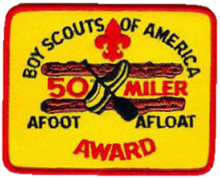
50 Miler Award
To recognize members who cover the trail or canoe or boat route of not less than 50 consecutive miles; take a minimum of five consecutive days to complete the trip without the aid of motors.
Austin March

Slide 10
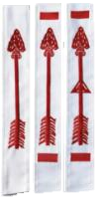
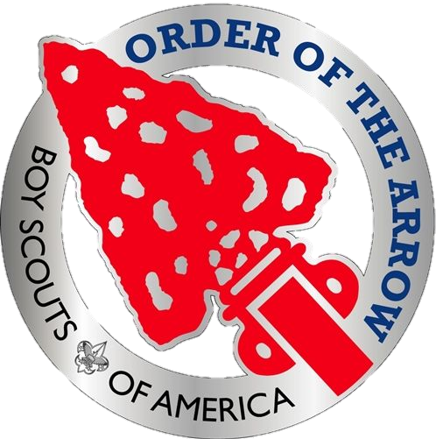
Order of the Arrow
Arrowmen – Carson Harrop
Brotherhood
Vigil Honor
The OA is the National Honor Society of the Boy Scouts of America, composed of Scouts and Scouters who best exemplify the Scout Oath and Law in their daily lives as elected by their peers.

Slide 11
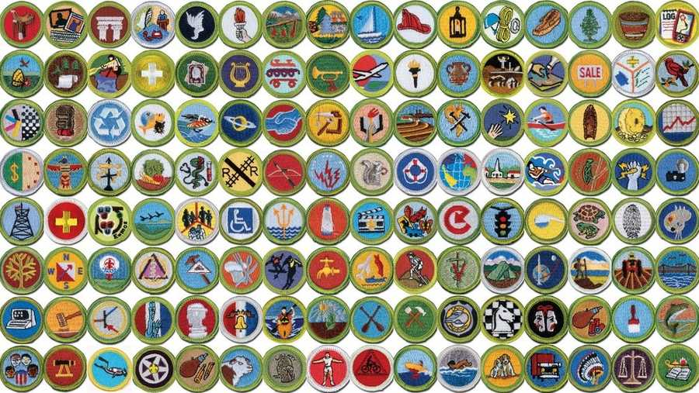
Merit Badges

Slide 12
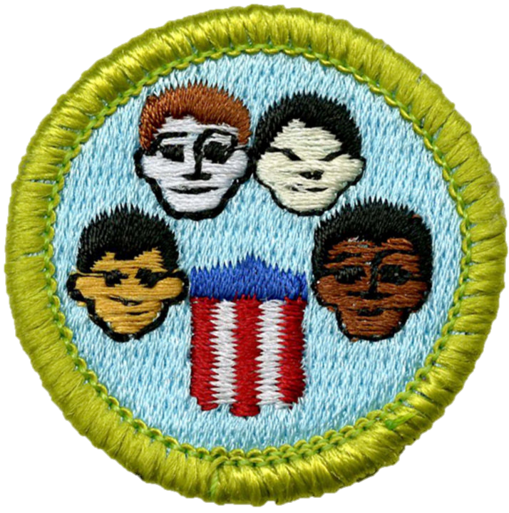
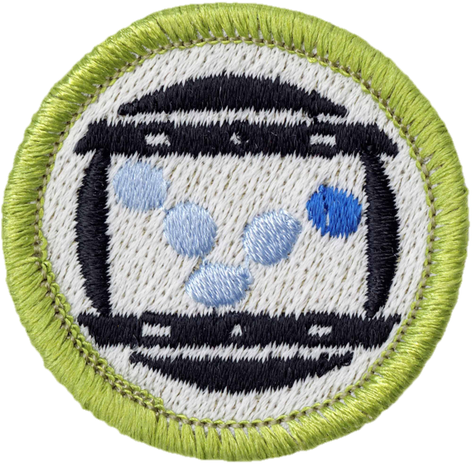
Jack Fairman
American Cultures
Animation
Citizenship in the World
Digital Technology

Slide 13
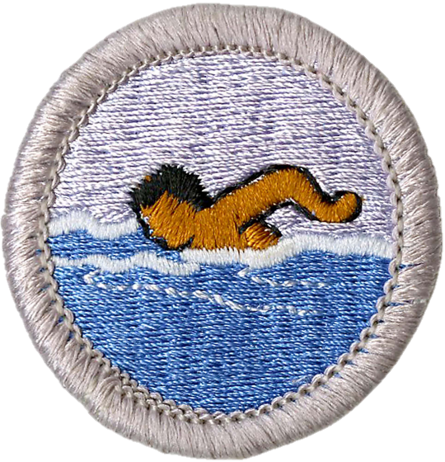
Broden Muller
Citizenship in the World
Fire Safety
Swimming

Slide 14
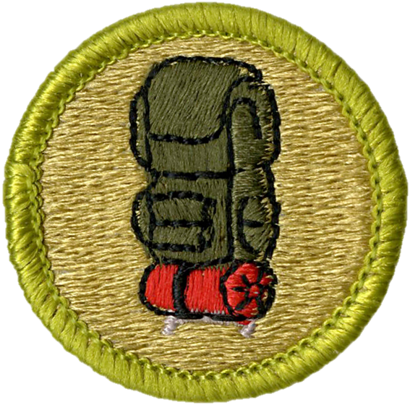
Austin March
Backpacking

Slide 15
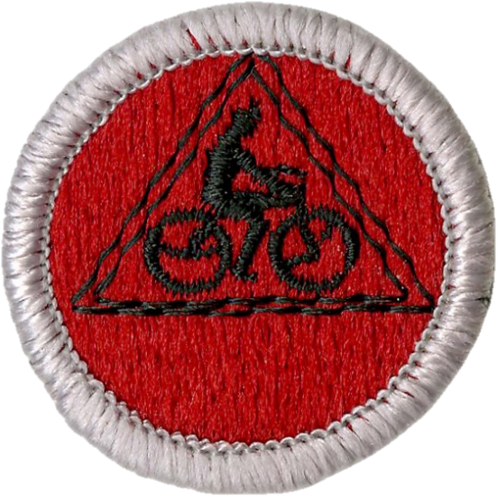
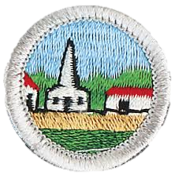
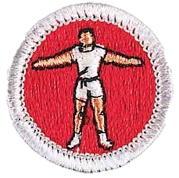
Zach Szklarz
Citizenship in the Community
Cooking
Cycling
Personal Fitness
Personal Management

Slide 16
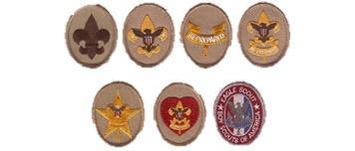
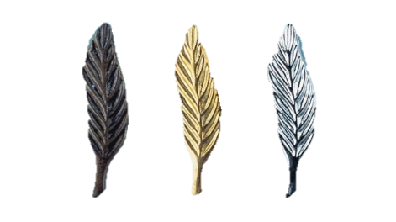
Rank Advancement

Slide 17
Scout Rank
Throughout the year we have the pleasure of welcoming new Scouts to our Troop. When each new boy joins the troop, he is encouraged to quickly earn the Scout Rank. To do this, a boy must learn the Boy Scout Oath, Promise and Law as well as the Scout Sign, Salute, and Handshake.

Slide 18
Scout Rank
We recognize the following Scouts this evening for earning the Scout Rank since our last Court of Honor:
None this evening

Slide 19
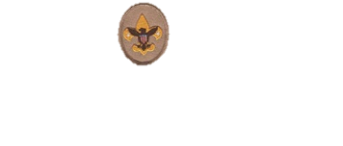
Tenderfoot Rank
Tenderfoot requirements offer a taste of the great adventures awaiting you in Scouting and can give you the basic skills you'll need to begin taking part in those adventures. You met many challenges in earning the Tenderfoot badge and are to be congratulated.

Slide 20
Tenderfoot Rank
We recognize the following Scouts this evening for earning the Tenderfoot Scout Rank since our last Court of Honor:
Landon Hays

Slide 21
Second Class Scout
To earn Second Class, a Scout must learn how to use a map and compass, how and when to build a campfire, and to safely use pocket knives and wood tools. Second Class Scouts have proven their abilities in camping, first aid, and swimming, and other Scout skills.

Slide 22
Second Class Scout
We recognize the following Scouts this evening for earning the Second Class Scout Rank since our last Court of Honor:
Broden Muller

Slide 23
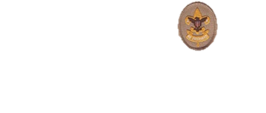
First Class Scout
The founder of Scouting, Lord Baden Powell, said that all Scouts should earn First Class. Now you have tested yourself even more. You have tried greater adventures and practiced your Scout skills many times. With your confidence and knowledge you now have, people will expect more of you, and you will expect more of yourself. You are prepared to be more of a leader in your patrol, your troop, and your community.

Slide 24
First Class Scout
We recognize the following Scouts this evening for earning the First Class Scout Rank since our last Court of Honor:
Jack Fairman
Broden Muller

Slide 25
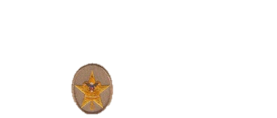
Star Scout
As you earn your Star Rank, you have more freedom to choose the directions that interest you. The focus shifts from basic Scout skills to earning the first six merit badges you will need for Eagle. Requirements now include service to others. The Star Rank also requires the Scout to be active in his troop for at least four months. Of course, you may take longer if you wish.
In addition, the Star Scout must serve his troop in a position of leadership for at least four months and take part in at least one service project.

Slide 26
Star Scout
We recognize the following Scouts this evening for earning the Star Scout Rank since our last Court of Honor:
None this evening

Slide 27
Life Scout
The Life Rank is one of the rarest ranks. This is the last rank before Eagle. You could complete your Eagle Rank now in as few as 6 months. We congratulate you and encourage you to reach for that next step. You have earned more than half of the merit badges required for Eagle.
The Life Rank also requires the Scout to be active in his troop for at least six months, serve his troop in a position of leadership for at least six months, and take part in at least one service project.

Slide 28
Life Scout
We recognize the following Scouts this evening for earning the Life Scout Rank since our last Court of Honor:
None this evening

Slide 29
Eagle Scout
The Eagle Rank is Scouting's highest award. Only a small percentage of Scouts have ever reached this lofty goal. The Eagle Rank is presented in a special Eagle Scout Court of Honor and not here this evening.

Slide 30
Eagle Scout
We recognize the following Scouts this evening for earning the Eagle Scout Rank since our last Court of Honor:
Ian Kleditz
Zach Szklarz

Slide 31
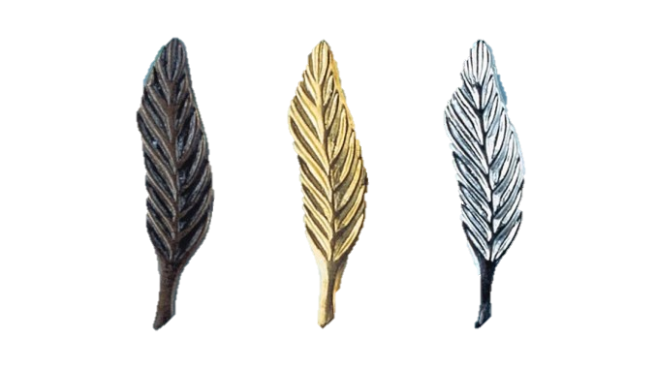
Eagle Palms
Some people think that after becoming an Eagle Scout, a scout has reached the end of the trail. That is not true. Scouts that continue to lead, serve, and grow as an Eagle, expanding scouting knowledge and sharing expertise with new scouts joining the troop may earn Eagle Palms. An Eagle Palm may be earned after 90 days of service to the troop, completion of 5 additional merit badges and a Scoutmaster Conference.
Silver + 15 Merit Badges
Bronze + 10 Merit Badges
Gold + 5 Merit Badges

Slide 32
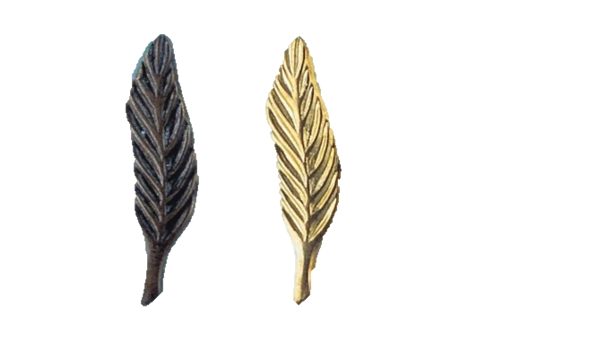
Eagle Palms
Zach Szklarz – 10 Additional Merit Badges
Bronze + 10 Merit Badges
Gold + 5 Merit Badges

Slide 33
Change of Leadership
Each six months, the Troop holds elections for Scout leadership. These elections were held last week, and new Scouts were chosen to lead the Troop for the next six months.
Mr. Boyd will now swear in our new Senior Patrol Leader, who will in turn, swear in the Assistant Senior Patrol Leader and the Patrol Leaders.

Slide 34
Senior Patrol Leader
“I promise to do my best -- to be worthy of the office of Senior Patrol Leader -- for the sake of my fellow Scouts and my troop -- and in the World Brotherhood of Scouting."
Senior Patrol Leader – Jack Fairman

Slide 35
Patrol Leaders
" I promise to do my best -- to be worthy of the office of [state your office] -- for the sake of my fellow Scouts -- in my patrol and troop -- and in the World Brotherhood of Scouting."
Assistant Senior Patrol Leader – Carsen Harrop
Patrol Leaders
Lasagna Cats – Tucker Anderson
Krakens – Broden Muller
White Tigers – Mathew Mehta

Slide 36
Scoutmaster Minute

Slide 37
Prayer

Slide 38
Closing Flag

Slide 40
Patrol
Leaders
Council
To follow after…

Slide 41
Thanks
For
Coming

